Slide 1
ANALYSIS OF CONSUMER BEHAVIOR FOR STRATEGIC GROWTH

Slide 2
PROJECT OVERVIEW
The project analyses consumer shopping behaviour using the transactional data from 3900 purchases across various product categories. The goal is to provide insights into spending patterns, customer segments, product preferences, and subscription behaviour to guide strategic business decisions.

Slide 3
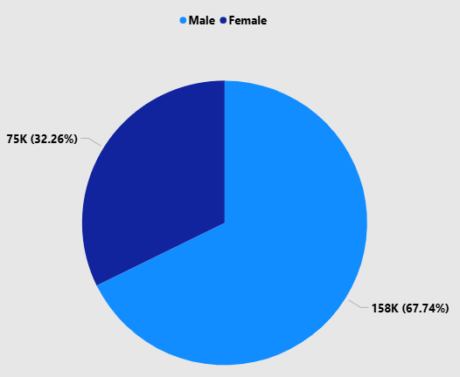
Gender distribution
Shows consumer base split.
Male consumers are higher.

Slide 4
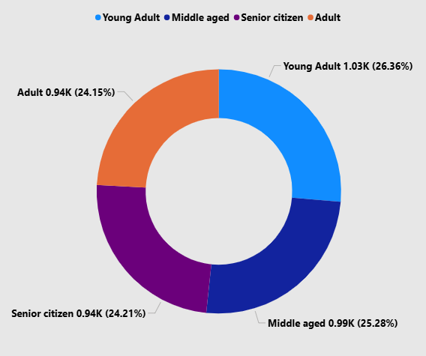
Age Distribution
Shows consumers spreads across age groups.
There is balances age demographic i.e. wide target audience.

Slide 5
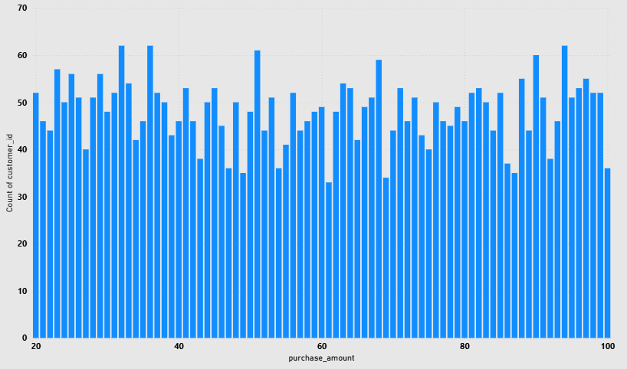
Purchase amount distribution
Shows spending behaviour.
Most consumers spends in mid-range.

Slide 6
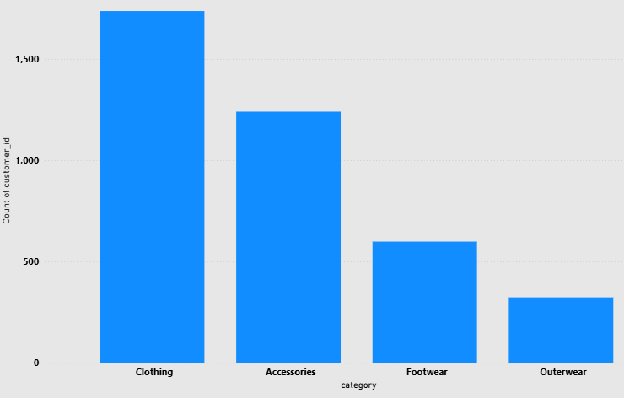
Category distribution
Highlights most purchased categories.
Clothing dominates, key revenue driver.

Slide 7
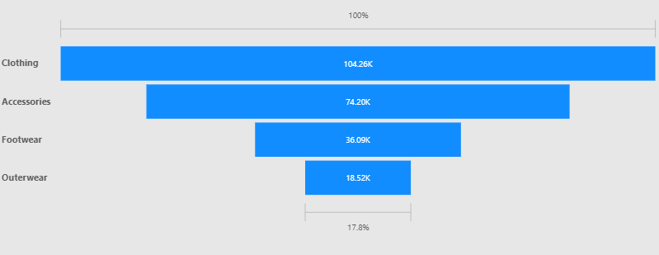
Purchased amount by category
Shows spending variation per category.
Some categories have higher value purchase.

Slide 8
Key Business Insights
Clothing is the top performing category.
Male consumers dominate revenue.
Discounts and promo codes increase engagement.
Repeat customers are highly valuable.
Subscription adoption is low, there is a growth opportunity.

Slide 9
Recommendations
Target female customers with personalised campaigns.
Increase subscription offers.
Use limited time discounts to boost conversions.
Introduce loyalty programmes and reward points system.
Track and improve review rating.
Use customer segmentation for target marketing.

Slide 10
Conclusions
The dataset reveals a loyal, moderately spending customer base with strong dependence on discount. Strategic focus on customer retention, subscription growth and targeted marketing can significantly improve business performance.

Slide 11
Thank you

